Slide 1


Slide 2
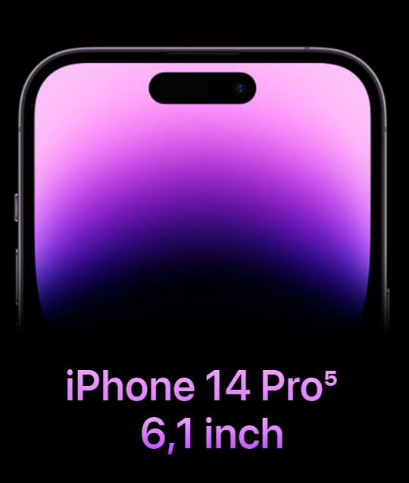
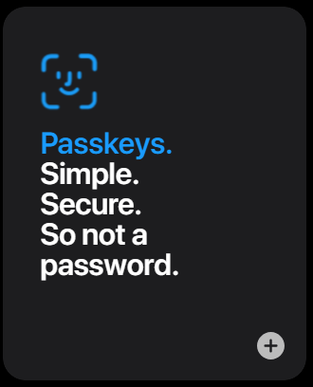
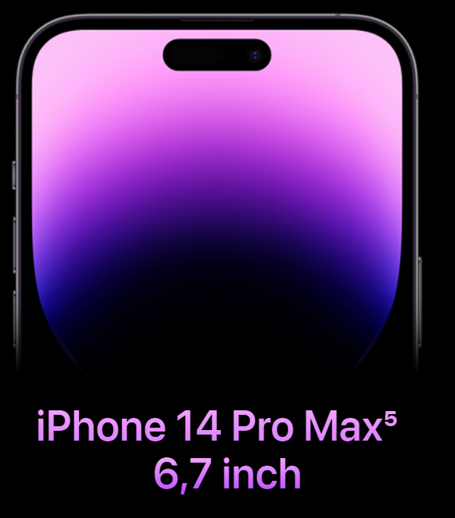
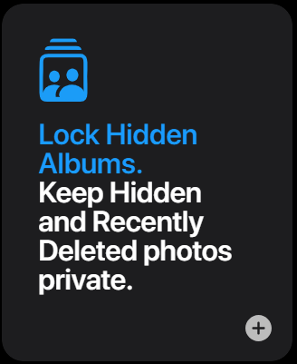
Handy Design
Accuracy and Security
Notes:
Handy design: - Offer two type of screen: 6. 1 inch and 6.7 inch, perfect in your hand
- Its sleek and modern design is a testament to both form and function
- Refining the materials for enhanced durability and aesthetics.
- It has been gradually reducing the bezels around the iPhone's display, providing a more immersive viewing experience
Accuracy and Security
Passkeys: - Using FaceID is more useful, user-friendly
- Quickly to authentication avoid time-consuming and bored each time authen - The passkey system on the iPhone 14 is so accurate
- Its implementation ensures a secure environment, bolstering the protection of sensitive data
Look Hidden Albums: - Protect to your private data
- Enjoy accurate touch responses while ensuring your privacy with advanced biometric security features

Slide 3
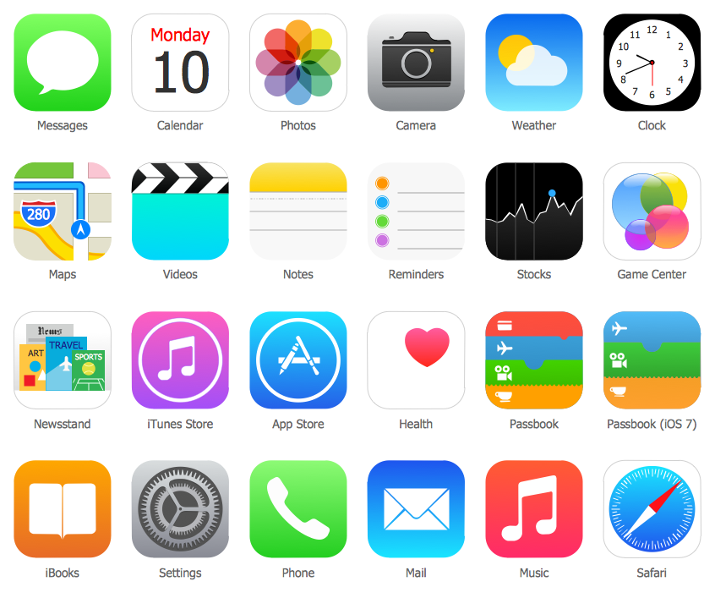
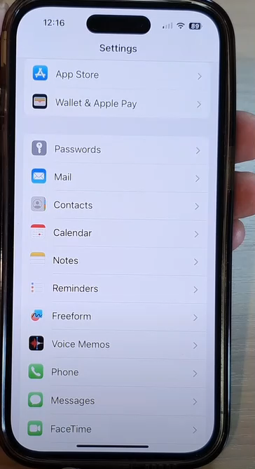
Efficiency &
Performance
User-Friendly Interface
Notes:
Efficient and performance: - Experience blazing-fast performance that keeps up with your dynamic lifestyle - Allowing you to accomplish more in less time - Stay ahead with regular updates that bring you the latest features
- Push notification fast
- Notify the upcoming event or meeting
User-Friendly Interface
- GUI and icon is user-friendly, easy to find and use
- Navigate effortlessly through the intuitive interface
- Designed to cater to both tech enthusiasts and newcomers

Slide 4
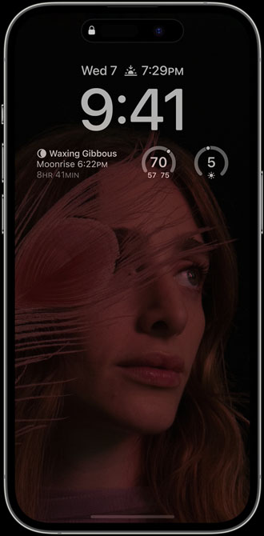
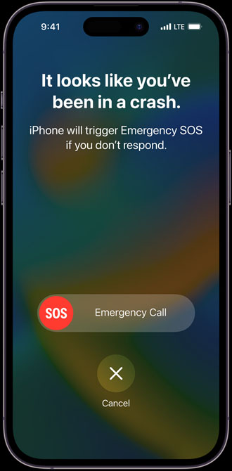
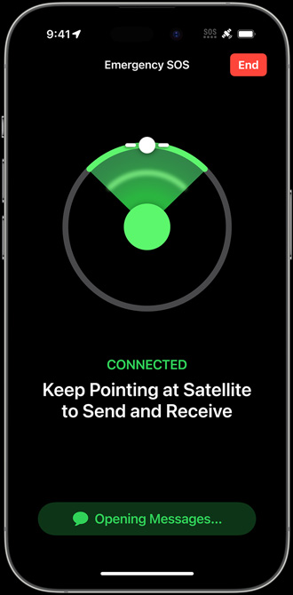
Always-On display
Crash Detection
Notes:
Handy design: - your personalized Lock Screen is always glanceable - so you don’t have to tap to see your favorite widgets like Weather, Calendar, or Lunar Phase Crash Detection - iPhone 14 Pro can detect a severe car crash,
- call 911 and notify your emergency contacts. - Hardware sensors and advanced motion algorithms - identify signs of a crash — including sudden changes in speed, direction, and cabin pressure.

Slide 5
THANKS

